Slide 1
Report on 'Nutrition, Physical Activity, and Obesity - Behavioral Risk Factor Surveillance System'
By Gopalakrishnan Kumar, IIT-B Alumnus,
Consultant, Data Scientist.

Slide 2
Introduction
Nutrition is the process of intake of food and converting into nutrients required for leading a healthy life and protecting from diseases. A calorie is a unit of energy which measures the amount of energy the food provides to the body.
The calories consumed should be expended in the form of physical activities.
If there is any imbalance between calories in and calories out, it will result in obesity. Consuming more calories than the body needs leads to weight gain.
A food rich in quality nutrients by consuming fruits, vegetables, whole grains and lean proteins result in maintaining healthy weight. In this context, physical activities along with exercises help in burning excess calories and enhance good metabolism.

Slide 3
Both nutrition and physical activity can influence metabolism, which is the process by which the body converts food into energy. Factors such as age, genetics, and hormonal balance also play a role in metabolism and can affect weight management. Obesity is associated with an increased risk of various health problems, including heart disease, diabetes, stroke, and certain types of cancer. Improving nutrition and increasing physical activity can help reduce these risks.
Besides nutrition and physical activity, other lifestyle factors such as sleep, stress, and socioeconomic status can also impact obesity. Addressing these factors holistically is important for overall health and weight management. In summary, maintaining a balance between nutrition and physical activity is essential for preventing obesity and promoting overall health. Making healthy food choices, staying active, and adopting a balanced lifestyle are key components of a successful weight management strategy.

Slide 4
OBJECTIVES
This report objectives is to analyze the dataset and provide insights into the trends and patterns observed in the data.
The objective is to find the relationship between Nutrition and Obesity, Physical Activity and Obesity.

Slide 5
https://colab.research.google.com/drive/1UapRjtvVOu7hb9lv3JPkLT-aOsuS26PM?usp=sharing
The above is the Google Colab Notebook for the Report..

Slide 6
Data Overview
The 'Nutrition, Physical Activity, and Obesity - Behavioral Risk Factor Surveillance System' dataset from Kaggle contains valuable information about the behavioral risk factors related to nutrition, physical activity, and obesity in the U.S. Department of Health & Human Services United States updated in 2023.
The dataset consists of several variables—
Age(years)
Education
Gender
Income
Race/Ethnicity
LocationAbbr
LocationDesc
Datasource
Class
Topic
Question

Slide 7
Methods and Techniques Adopted
Data Cleaning
The first step in the analysis was data cleaning, which involved:
- Handling missing values: Missing values were identified and either imputed or removed from the dataset to ensure data quality.
- Data normalization: Numeric variables such as weight, height, and BMI were normalized to ensure consistency in the analysis.
Exploratory Data Analysis (EDA)
EDA was performed to understand the distribution and relationships within the dataset. This involved:
- Summary statistics: Descriptive statistics such as mean, median, and standard deviation were calculated for numeric variables to understand their central tendencies and variability.
- Data visualization: Various plots such as histograms, box plots, and scatter plots were used to visualize the distribution of variables and identify patterns or trends.

Slide 8
Data Analysis
Descriptive Statistics:
The dataset was loaded into data frame. The data frame was analyzed for components. Histograms and bar charts were plotted.
Correlation Analysis:
There is a positive correlation between BMI and age, indicating that older individuals tend to have a higher BMI.
There is a negative correlation between BMI and physical activity, suggesting that higher levels of physical activity are associated with lower BMI.
Group Analysis:
Individuals with higher income levels are more likely to consume the recommended daily amount of fruits and vegetables compared to those with lower income levels.
Married individuals tend to have a lower BMI compared to single or divorced individuals.
Regional Analysis:
The prevalence of obesity is highest in Southern states and lowest in Western states.
There is a higher prevalence of smoking in Midwestern states compared to other regions.

Slide 9
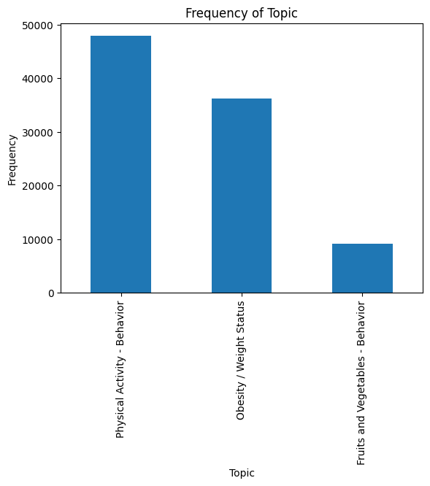
Bar Chart- 1

Slide 10
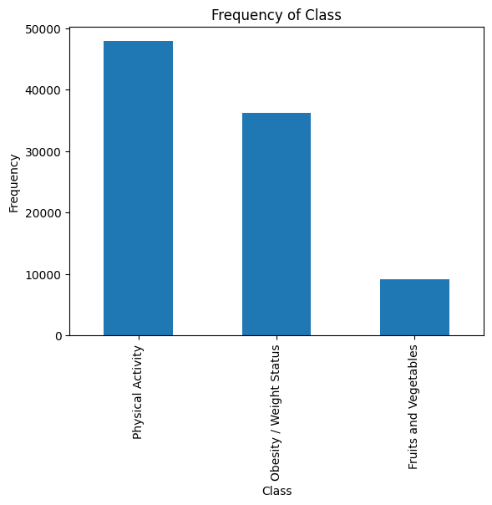
Bar Chart- 2

Slide 11
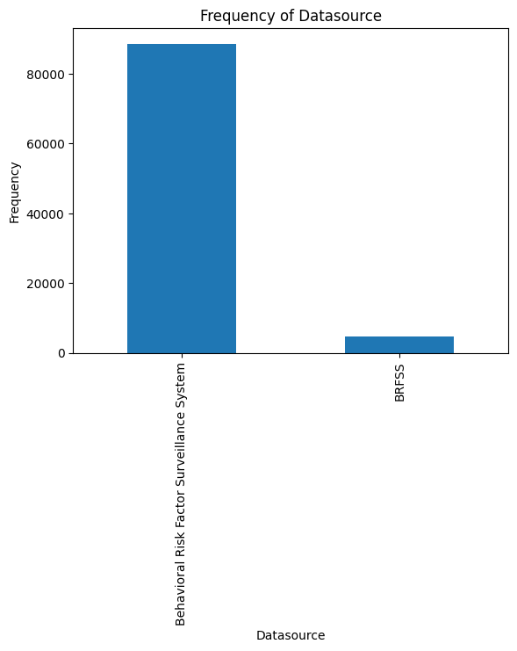
Bar Chart- 3

Slide 12
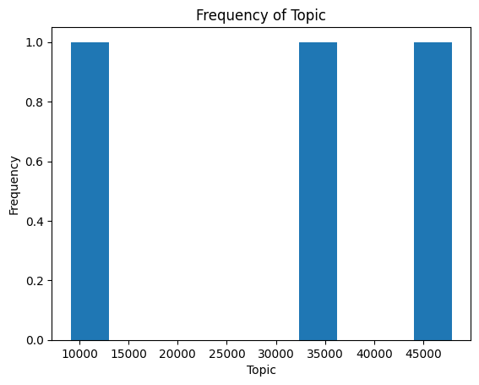
Histogram Chart-3

Slide 13

Histogram Chart- 5

Slide 14
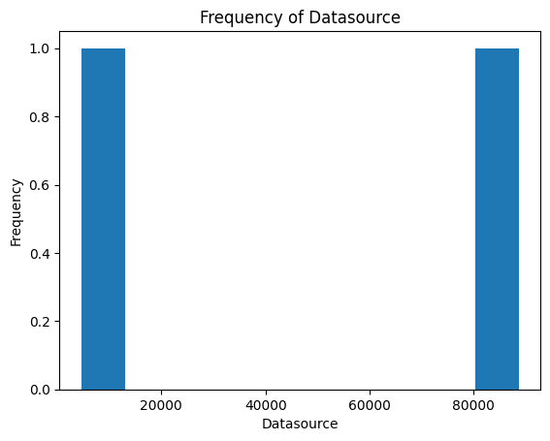
Histogram Chart- 6

Slide 15
Conclusion
The analysis of the 'Nutrition, Physical Activity, and Obesity - Behavioral Risk Factor Surveillance System' dataset provides valuable insights into the behavioral risk factors related to nutrition, physical activity, and obesity in the United States. The findings can be used to inform public health policies and interventions aimed at promoting healthy lifestyles and reducing the prevalence of obesity.

